Slide 1
Docker Container Orchestration

Slide 2

Docker Compose
https://docs.docker.com/compose/
The key features of Compose that make it effective are:
Have multiple isolated environments on a single host
Preserves volume data when containers are created
Only recreate containers that have changed
Supports variables and moving a composition between environments

Slide 3
Docker Compose
Using Compose is a three-step process.
Define your app’s environment with a Dockerfile so it can be reproduced anywhere.
Great for running / Testing application in Dev / staging / QA and CI environments.
Define the services that make up your app in docker-compose.yml so they can be run together in an isolated environment.
Lastly, run docker-compose up and Compose will start and run your entire app.

Slide 4
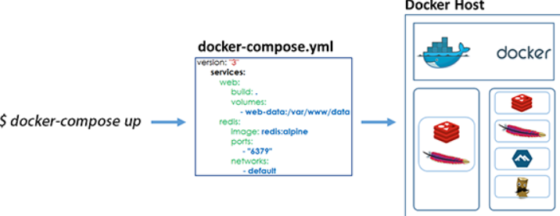
Docker-compose High Level picture

Slide 5

Docker-compose YAML file
A sample Docker-compose YAML
version: ‘3’
services:
wordpress:
image: wordpress:latest
ports:
- 8080:80
environment:
WORDPRESS_DB_PASSWORD: abc123
mysql:
image: mysql:latest
environment:
MYSQL_ROOT_PASSWORD: abd123$

Slide 6
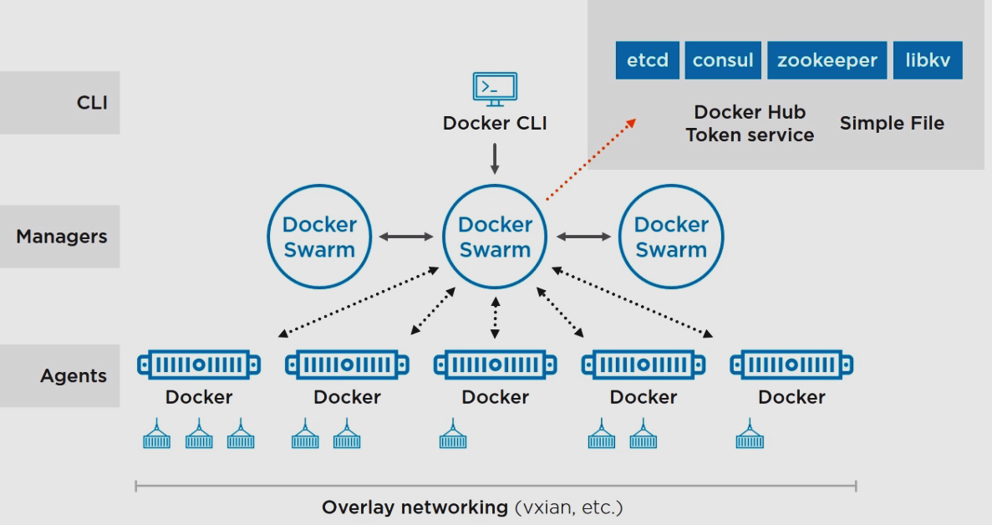

Docker- Swarm Architecture

Slide 7

Docker- Swarm
To initiate the cluster use below command,
$ docker swarm init --listen-addr 192.168.33.10:2377 --advertise-addr 192.168.33.10
To add a worked node to the cluster, we can use below command.
$ docker swarm join –token <autogenerated-token> 192.168.33.10:2377
List nodes in the swarm cluster
$ docker node ls
Deploy multiple containers in the swarm cluster.
$ docker service create --replicas=4 --name=webapp ganeshhp/apache2:latest

Slide 8
Thank You

